Slide 1
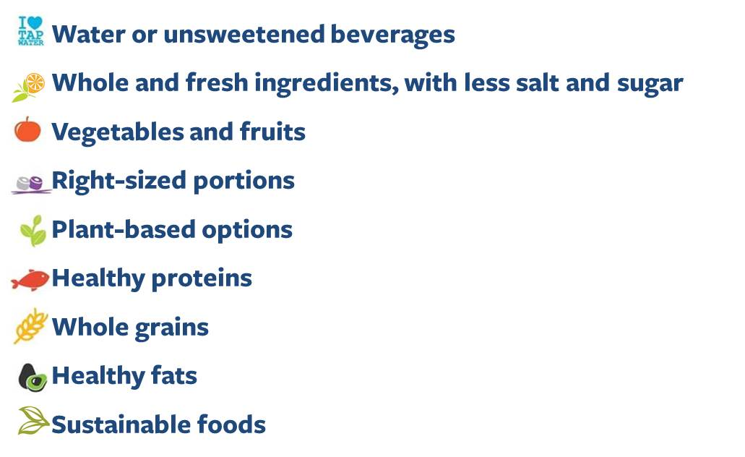
Your logo here
[name of group/caterer]
is proud to offer a variety of healthier food choices
Eat Well Berkeley, sponsored by Be Well at Work - Wellness Program for UC Berkeley faculty and staff, seeks to make healthier choices more accessible. uhs.berkeley.edu/eatwellberkeley

